Slide 1
Unipicture
A Multifunctional Image Editor
Ran Hu, Shaoyu Wang, Jiayi Qiu, Zhixian Hu, Xuening Zhang, Jinjing Yang

Slide 2
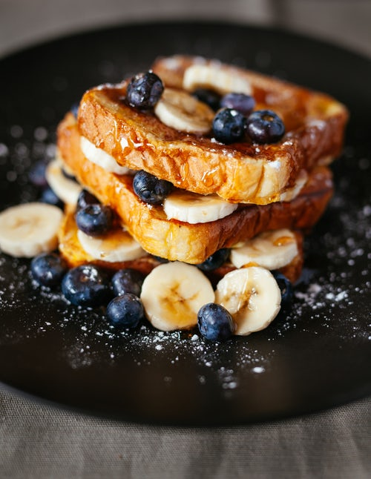
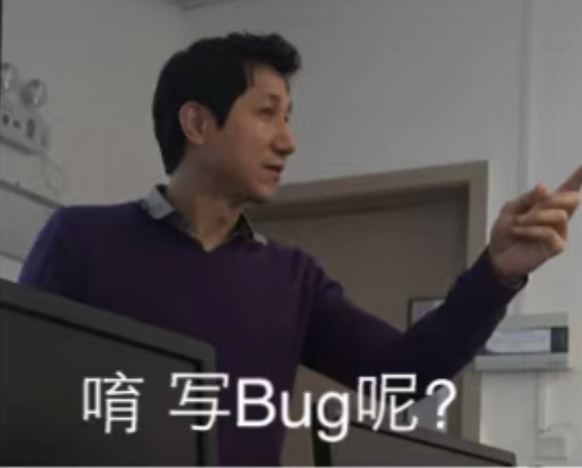
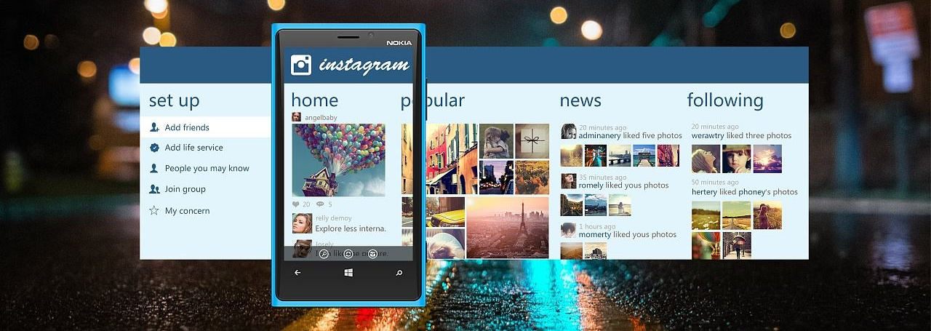
Background
Take Photos → Edit Images → Share Pictures

Slide 3
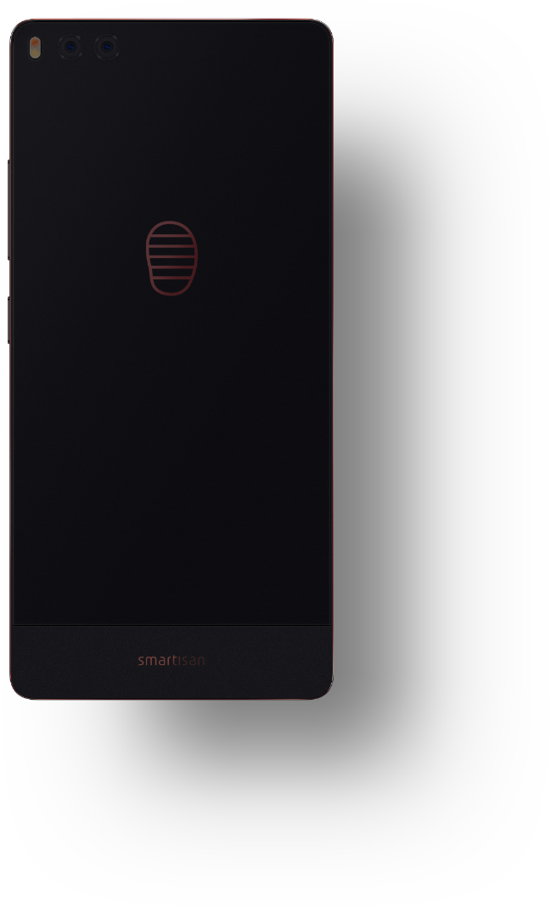
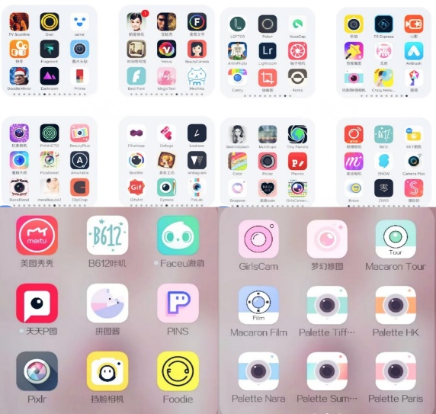
Motivation
Have you used any image processing App?

Slide 4
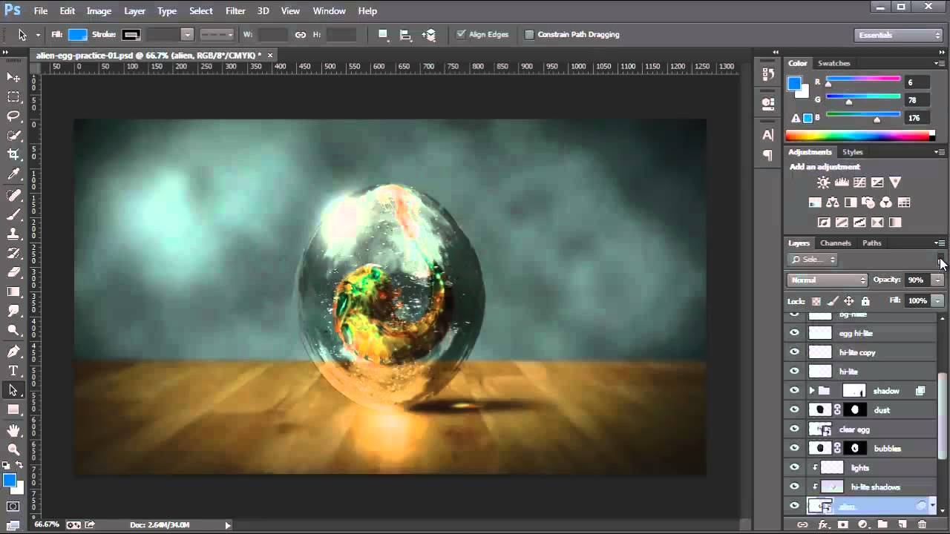

Motivation
Have you used any
image processing software ?

Slide 5
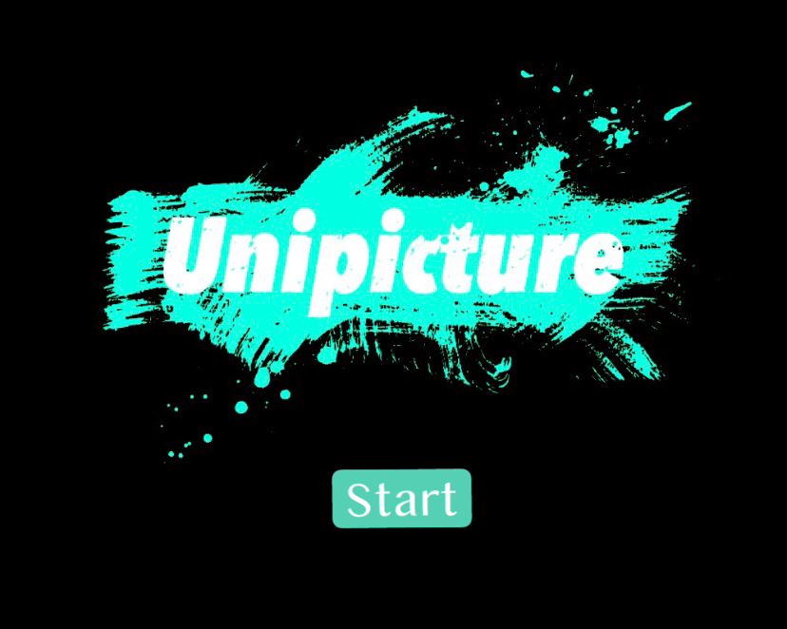
Solution

Slide 6
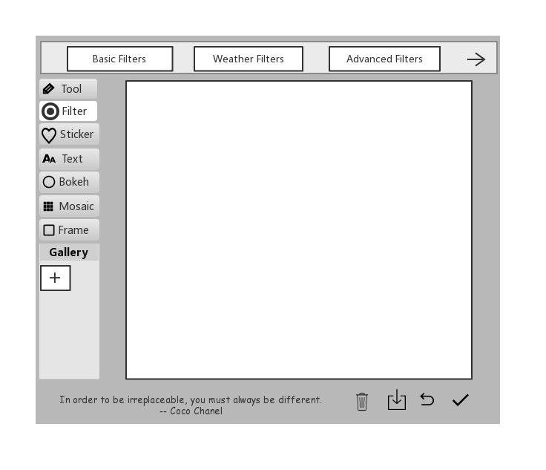
Solution
GUI Design

Slide 7
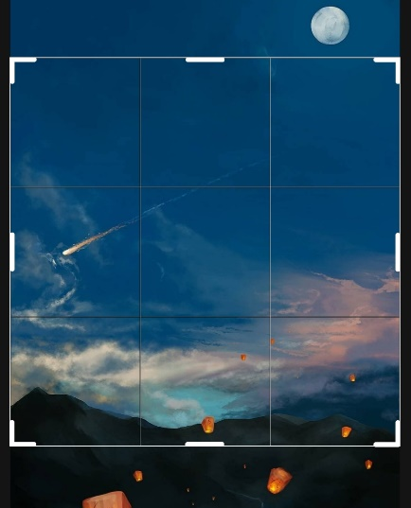
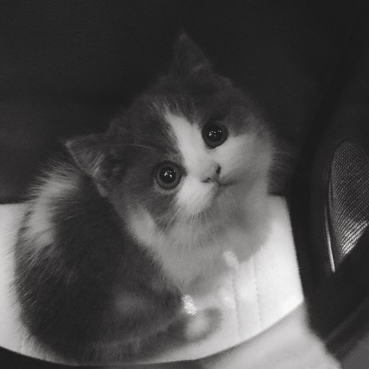
Solution
Basic Operations
Crop
Flip
Black & white mode
Rotate
Brightness & contrast
Filtering a specific color

Slide 8
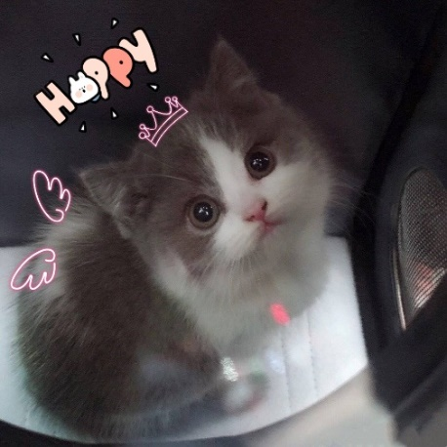
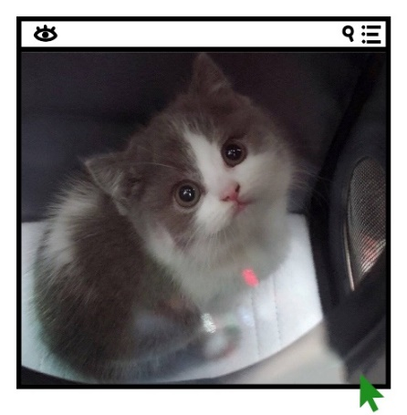
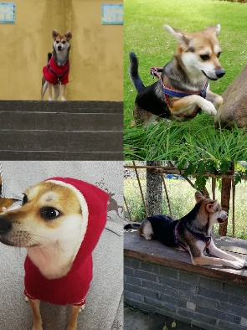
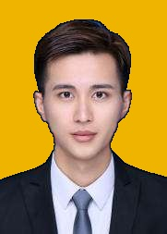
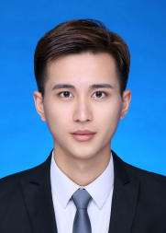
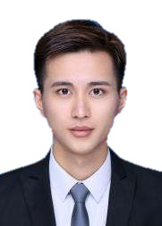
Solution
Advanced Operations
Sticker
Frame
Mosaic
Text
Collage
Background Changing

Slide 9



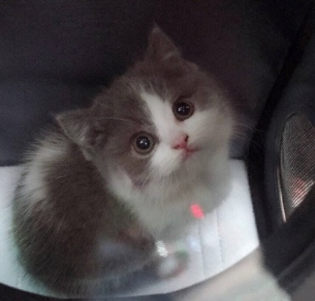
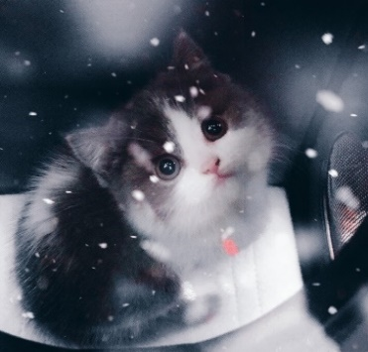
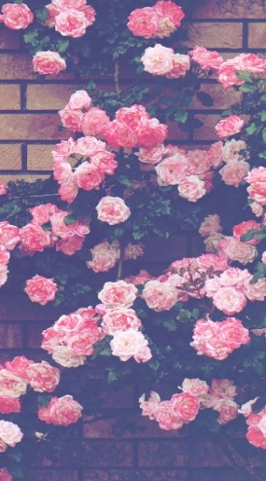
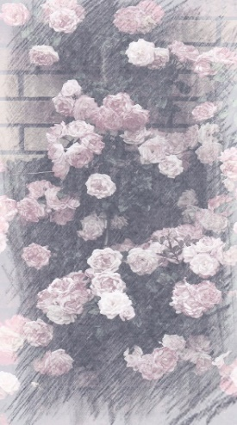
Solution
Filters
Basic Filters
Weather Filters
Advanced Filters

Slide 10
Implementation & Resources

Slide 11
Schedule
week | Plan
9 | Write codes to implement all the functions
10
11
12
13 | Integrate codes
14
15 | Write the final report
16 | Test and adjustment

Slide 12
Division of Work
Name | Division
Ran Hu | functions design, loading & saving photo
Shaoyu Wang | mosaic, background changing
Jiayi Qiu | GUI design
Zhixian Hu | basic operations on photo
Xuening Zhang | stickers, text, and collage
Jinjing Yang | filters

Slide 13
Thank You
If you have any questions, please contact ranhu@link.cuhk.edu.cn

